Slide 1
STAT 685: Distracted Driving
Committee: Dr. Derya Akleman, Dr. Samiran Sinha, Dr. Ergun Akleman Bryan Yu | bryanyu@tamu.edu

Slide 2
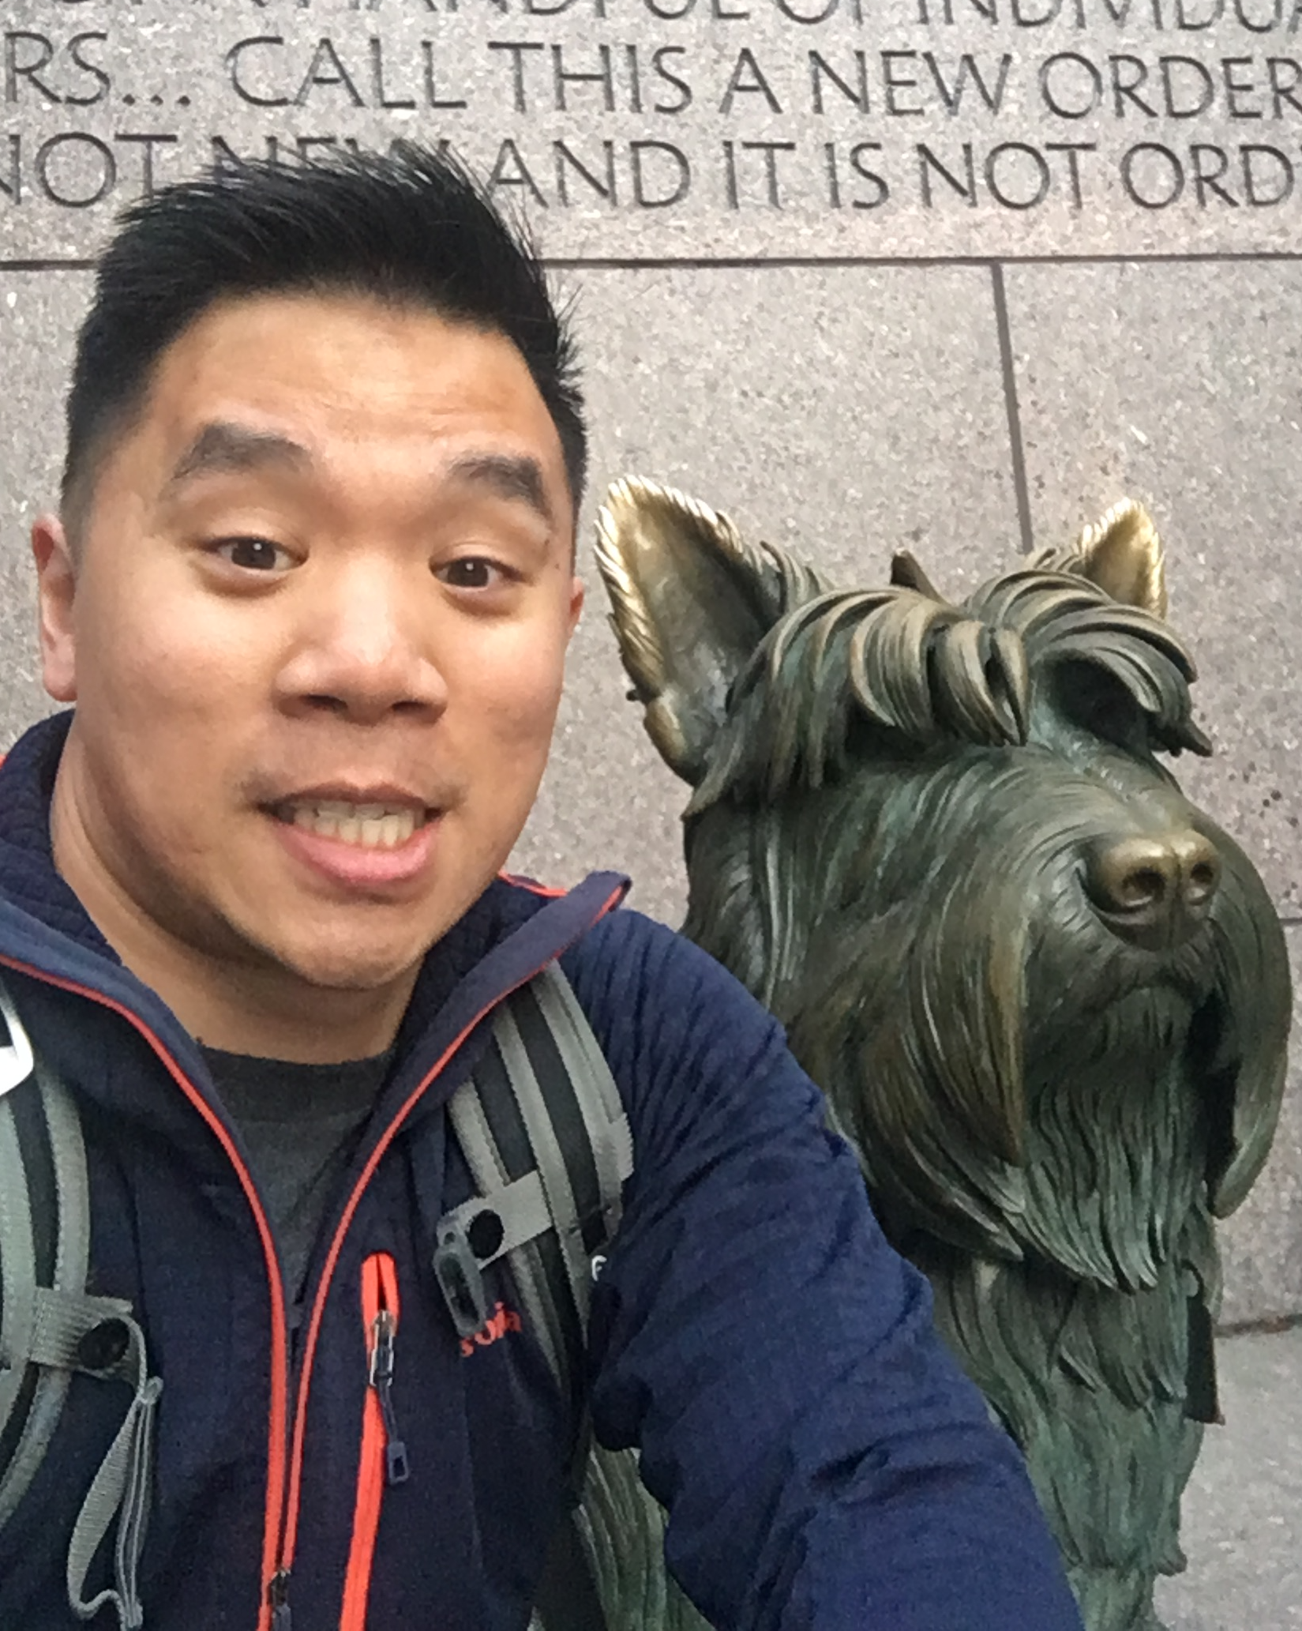
About me: Bryan Yu
○ Currently work in finance (data analyst/engineer) in Austin, TX
○ Graduated from UT-Austin 2009, BS Aerospace Engineering
○ Spent 4 years on the west coast but moved back to Texas in 2015
○ Interests
Intellectual: Econometrics
Personal: Weightlifting and calisthenics
Graduation Present: Dog

Slide 3
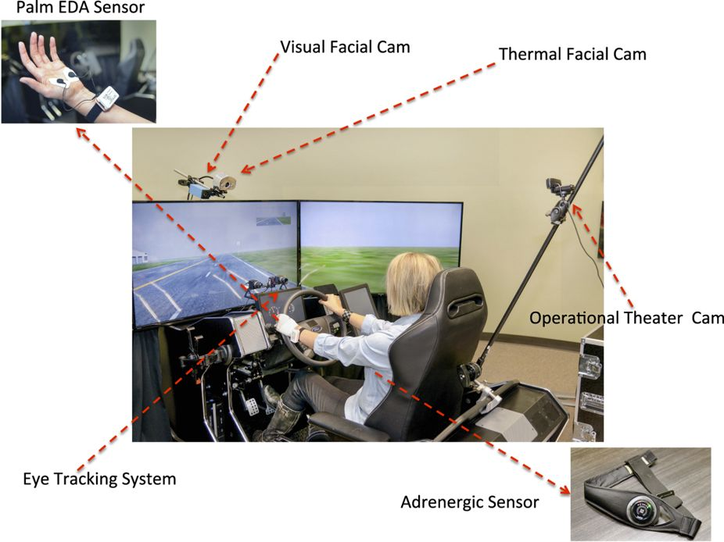
Experiment
Controlled simulated driving experiment¹ to asses driving behavior
Multiple different stressors: cognitive, emotional, sensorimotor (texting)
Each driver (N=68) had 4 different drives to assess stressors including control
Sensors captured vehicle information and driver outputs
Subject variables: age, gender, personality
Drive variables: Speed, brake, lane position
Biological variables: eye gaze, heart rate, breathing rate, etc

Slide 4
Project Objective
Model variance of lane positioning to quantify texting effect
Explore population level effects on variance
Age, Gender, Personality (Type AB, Anxiety score)
Bayesian modelling
Time series analysis
Stan MCMC Programming: Sampling with Hamiltonian Monte Carlo
“Modern Statistical Workflow”²: Capture simulated data before fitting observations

Slide 5
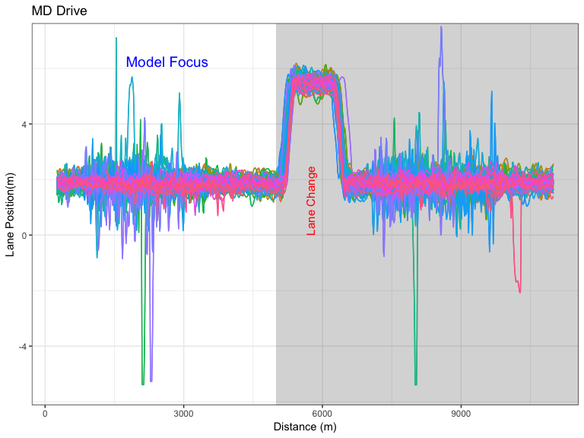
Data Preparation
Focused only on the sensorimotor (MD) / texting drive
Focused on first half (prior to lane change)
Filtered out drivers with missing LaneOffset data (N=62)
Data downsampled to 200 data points per driver
62 drivers * 200 datapoints = 12,400 records
Each color is a separate driver (N=68)
Some drivers exhibit extremely long tails in their lane positioning

Slide 6
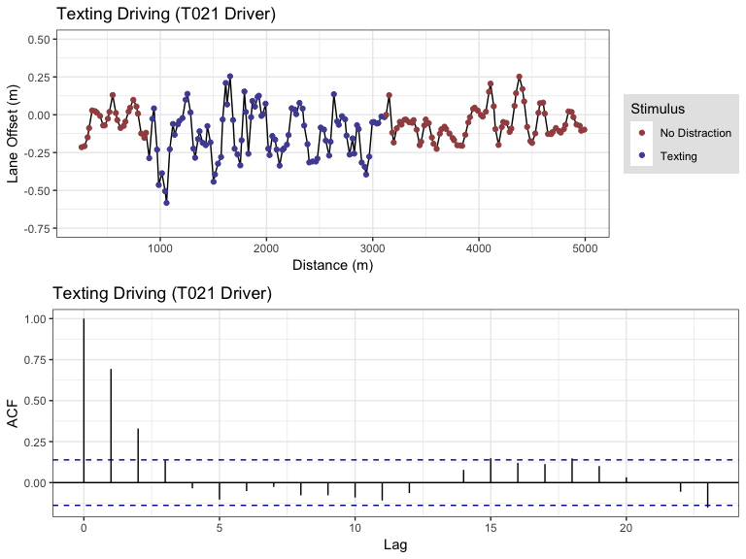
Preliminary Analysis: T021 Driver
Univariate (T021) data is stationary according to the Dickey-Fuller Test
Accounting for texting vs normal driving
Higher variance in LaneOffset when driver is texting
Data exhibits an autoregressive structure in the correlogram and plot of the LaneOffset

Slide 7
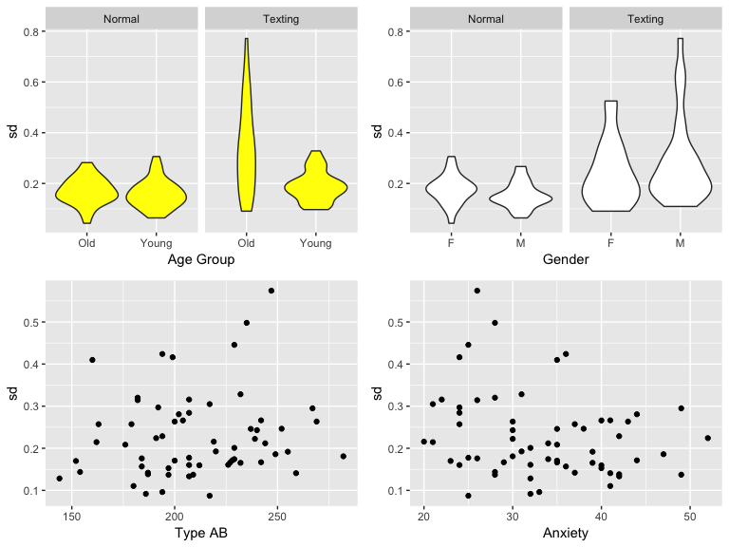
Preliminary Analysis: All drivers
Age effect appears to have significant interaction effect with texting
Gender and personality level effects (anxiety score, Type A/B) do not appear to have significant effects with regard to driving variance
With a sample size of $N_{drivers}=62$, not enough power to test other interactions

Slide 8
Modelling
Univariate model (T021 driver)
○ AR(1): Texting effect
$$y_{t}∼Normal(α+ρy_{t−1},σ_{0}+δ_{j_{0}})$$
Multivariate model (all drivers)
○ AR(1): Additive effects (pooled individuals)
$$μ=α+ρy_{t−1,i}$$
$$σ=σ_{0}+σ_{i}+δ_{j_{0}}+δ_{j,i}$$
$$y_{t,i,j}∼N(μ,σ)$$
○ AR(1): Multiplicative effects (texting & age)
$$σ=σ_{0}*exp[log(σ_{k})+log(σ_{j,k})]$$
$$y_{t,i,j,k}∼N(μ,σ)$$
$$y:LaneOffset$$
$$t:Distance (n = 200)$$
$$i:Drivers (n = 62)$$
$$j:Texting (n = 2)$$
$$k:Age (n = 2)$$
Priors
$$α∼N(0,1)$$
$$ρ∼Uniform(0,1)$$
$$σ_{0},δ_{j_{0}}∼Half-normal(0,1)$$
$$σ_{i},δ_{j,i}∼Half-normal(0,σ_{γ})$$
$$σ_{γ}∼Half-normal(0,0.1)$$
$$log(σ_{j}),log(σ_{j,k})∼N(0,1)$$

Slide 9
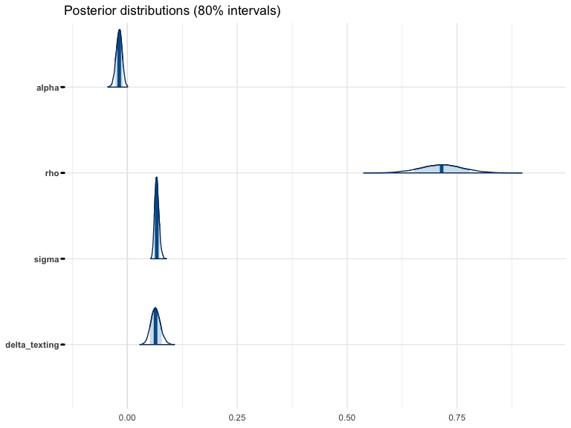
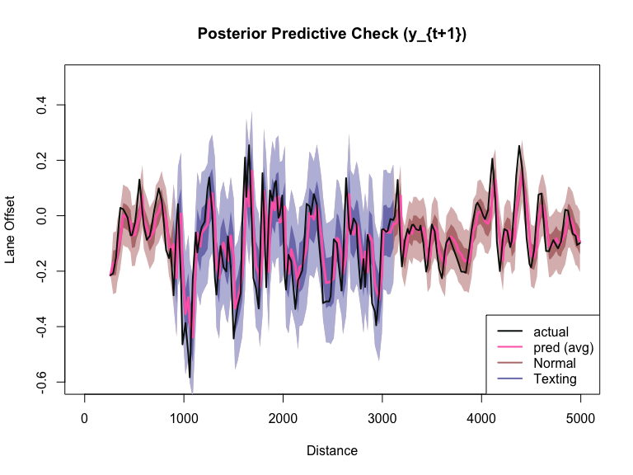
AR(1) Univariate: Results

Slide 10
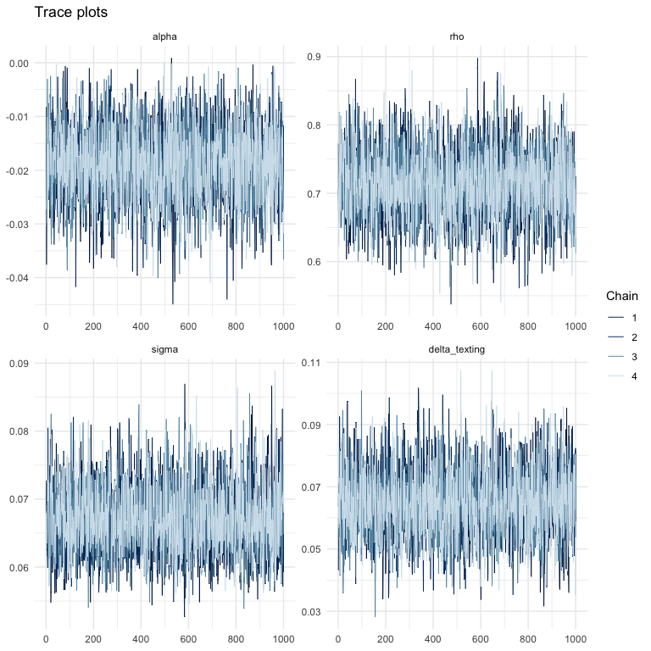
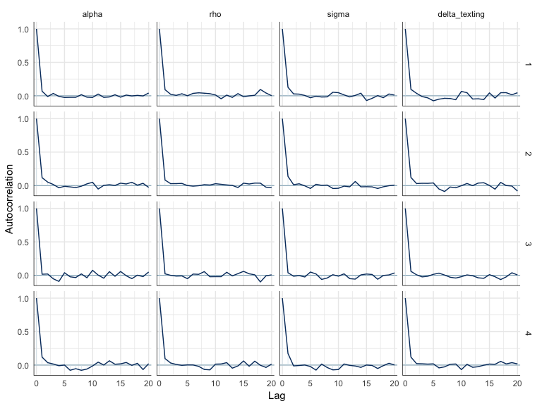
AR(1) Univariate: Diagnostics

Slide 11
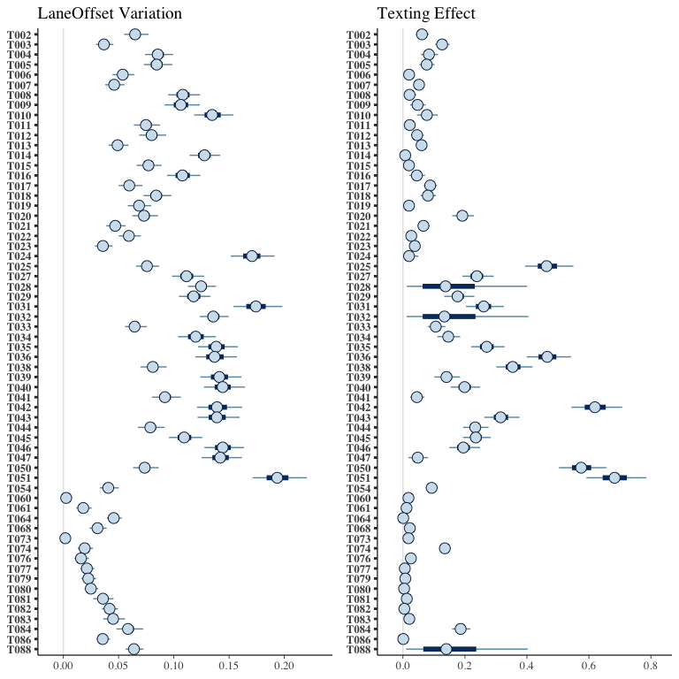
AR(1) Multivariate Additive: Individual results
Large variation between individuals
Clusters of population exist where the effect of texting and the base variation of lane offset correlate
Drivers who have high variation in lane positioning have correspondingly higher variation when texting

Slide 12
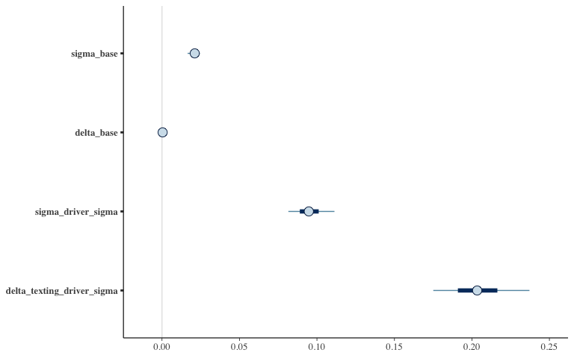
AR(1) Multivariate Additive: Hyperprior results
Pooling forces variability of the $δ_{j_{0}}$ to zero but variability is now within all the drivers
Hyperpriors show that the texting effect doubles the lane position variance for the individual drivers

Slide 13
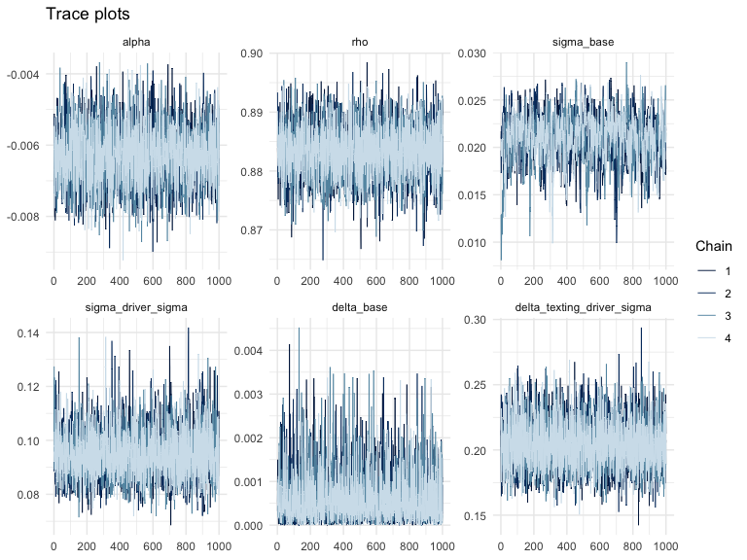
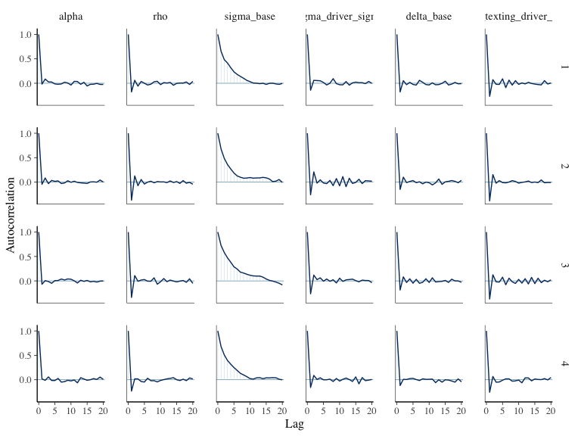
AR(1) Multivariate Additive: Diagnostics

Slide 14
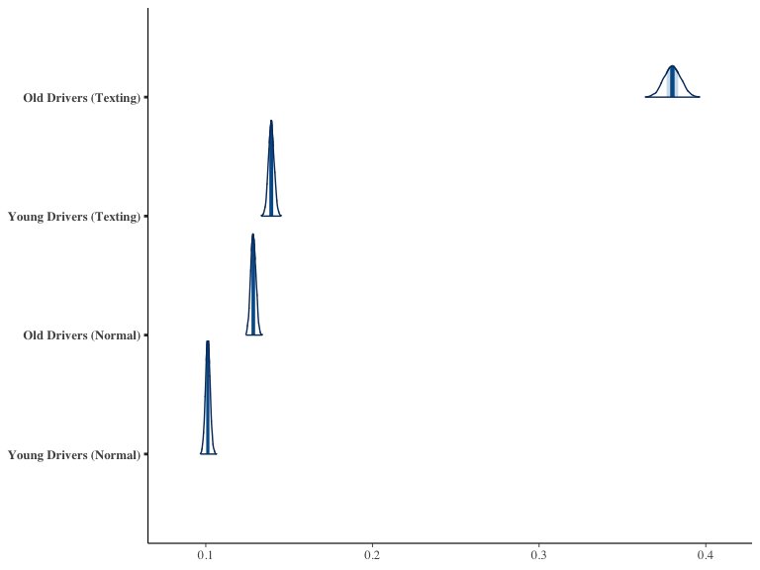
AR(1) Multivariate Multiplicative: Results
Older drivers have higher lane position variance in both non-texting and texting situations
The interaction effect between texting and the age group causes the posterior distribution to be much wider
The large variation between individual drivers when texting contributes to the larger posterior of the texting effect
Much longer right tails in the lane position variance

Slide 15
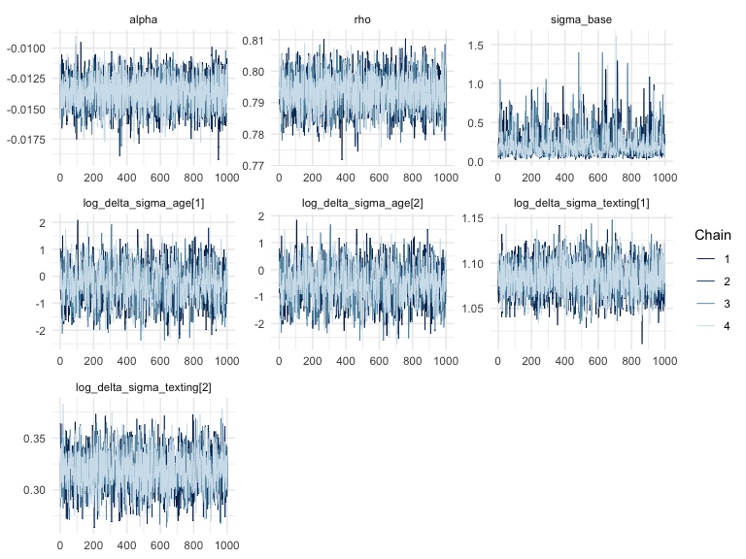
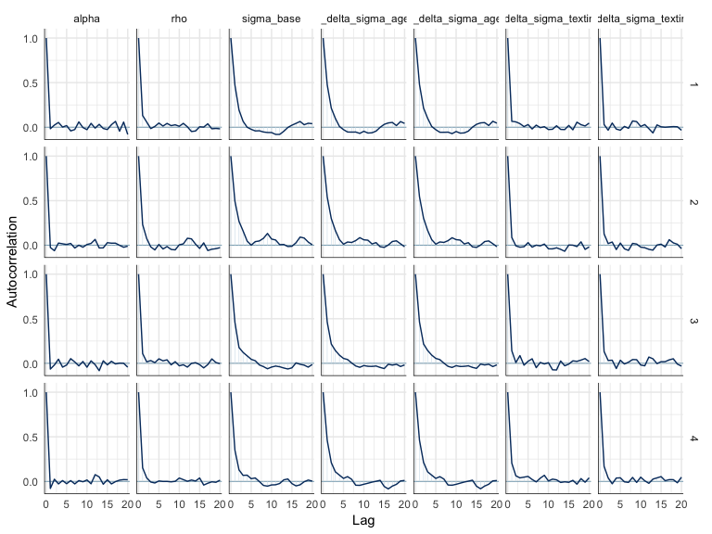
AR(1) Multivariate Multiplicative: Dianostics

Slide 16
Conclusions
On average, with the additive model, the presence of texting effect doubles the variance of lane positioning
Large variation between drivers
Drivers with higher lane position variance -> higher lane position variance when texting
Older drivers exhibit increased variance for both texting and non-texting
Multiplicative model: Significant interaction effect with age and texting

Slide 17
Backup slides

Slide 18
References
Taamneh, S. et al. A multimodal dataset for various forms of distracted driving. Sci. Data 4:170110 doi: 10.1038/sdata.2017.110 (2017).
Betancourt, Michael. 2018. “A Principled Bayesian Workflow” June 2018
Kim, Shephard, Chib (1998) “Stochastic Volatility: Likelihood Inference and Comparison with ARCH Models” The Review of Economic Studies Vol. 65, No. 3
Stan Development Team. “Stan Modeling Language User’s Guide and Reference Manual” Version 2.17.0, Sept 2017

Slide 19
Computing Cluster Setup (Amazon Web Services)
Prior Predictive Modelling
Each prior predictive model runs 1000 simulations from the generative model
Fitting 1000 simulations is a time consuming process on local machine
Stan runs 4 markov chains in parallel and aggregates (4 cores)
1000 * 4 = 4000 CPU’s to run fit observations for one model!
Created a docker container with RStan and submitted jobs to AWS Batch service

Slide 20
Future steps
Incorporate bayesian methods for dealing with missing data
Incorporate “change-point” model to account of lane changes
Determine better methods for posterior predictive checking for time series data
Correlogram & Variogram

Slide 21
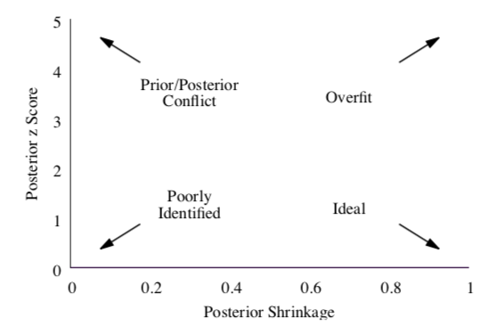
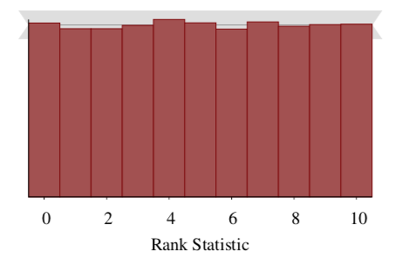
Prior Predictive Fit Tests
Shrinkage
Simulation Based Calibration

Slide 22
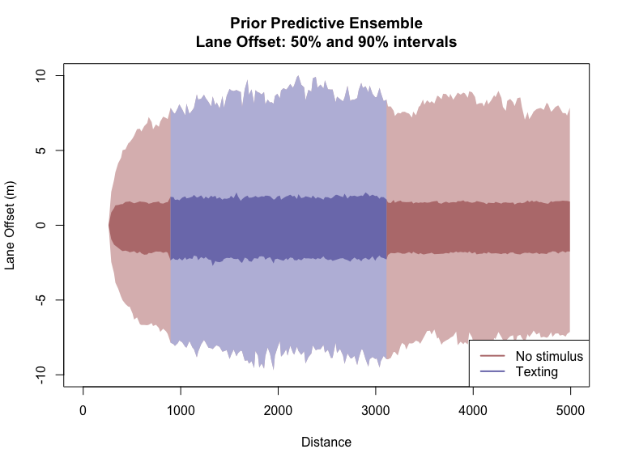
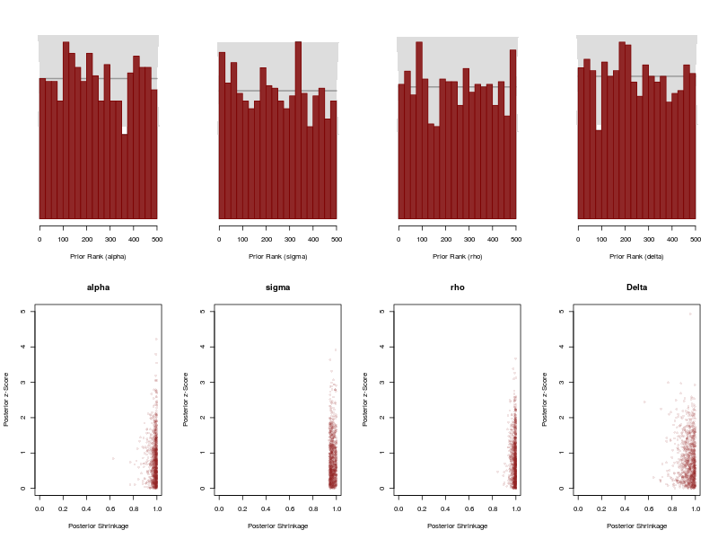
AR(1): Prior Predictive Analysis

Slide 23
Stochastic Volatility: Setup
Conceptual Analysis
Mean of lane offset is constant but with changing volatility. The SV model has additional parameters to deal with the structure of this data. Latent variables and generative nature of model allows for additional complexity.
Define observations
$$T:Number of observations$$
$$N_{texting}:Number of texting states (j)$$
$$y_{t}:Lane Offset (meters), mean corrected$$
$$x_{t}:Texting indicator (1: ND, 2: MD)$$
Likelihood and priors
$$y_{t}∼N(0,exp(h_{t}/2))$$
$$h_{t}∼N(μ+δ+ϕ(h_{t}−μ),σ)$$
$$h_{1}∼N(μ,\frac{σ}{\sqrt{1−ϕ^{2}}})$$
$$μ∼N(0,1):Mean log volatility$$
$$ϕ∼Uniform(−1,1):Persistence of volatility$$
$$σ∼N(0,1)$$
$$δ∼N(0,0.05):Texting effect$$

Slide 24
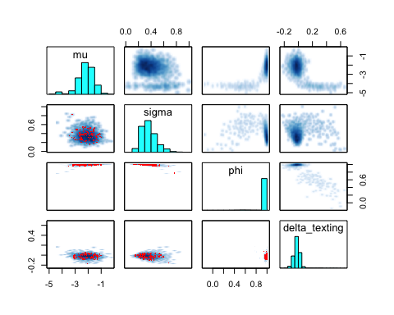
Stochastic Volatility: Fit Observations
Lots of divergences (red dots)
$ϕ$ parameter stuck near 1 indicating non-stationarity
On the default chain settings (n=2000, 4 chains), looks like there are two different modes
SV is not flexible enough to model this, HMM model maybe more appropriate

